Slide 1

Ladder Safety Training
Notes:
This training focuses on ladder safety, a critical topic for preventing injuries in construction and other industries. We'll cover essential safety practices and regulations to help you work confidently and safely when using ladders.

Slide 2

Introduction
Falls from ladders are a leading cause of serious and fatal injuries in residential construction.
The goals of this course are to help you:
understand how to correct or eliminate fall hazards on your job sites related to ladder use.
understand the OSHA ladder safety requirements.
Notes:
Falls from ladders are a major cause of serious injuries and fatalities in residential construction. This course aims to equip you with the knowledge to identify and eliminate fall hazards related to ladder use. We'll also review OSHA's ladder safety requirements to ensure compliance and protect workers on site.

Slide 3

Course Objectives
Identify the importance of preventing falls from ladders.
Recognize fall hazards associated with ladder use.
Identify OSHA requirements for ladders.
Identify work practices for using ladders safely.
Notes:
Our objectives include understanding why preventing ladder falls is vital, recognizing common hazards, and knowing OSHA's ladder regulations. Additionally, we'll discuss safe work practices to minimize risks and promote a culture of safety when using ladders.

Slide 4
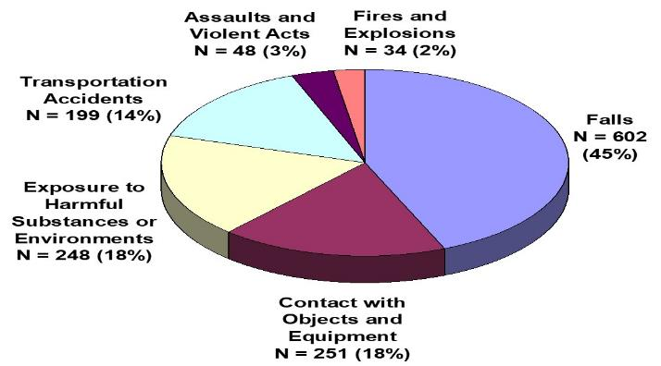
Why is Preventing Falls from Ladders Important?
Falls continue to be the leading cause of fatalities in residential construction.
Falls (602) were responsible for 45% of residential construction fatalities from 2003 to 2006.
135 (22%) were falls from ladders.
Notes:
Falls remain the leading cause of death in residential construction, with nearly half of fatalities linked to falls overall. Specifically, ladder falls account for a significant portion of these incidents. This highlights the urgent need for effective safety measures and awareness to reduce these preventable accidents.

Slide 5




How do you prevent falls from ladders?
Implement a comprehensive safety program.
Understand OSHA ladder regulations.
Train workers to identify hazards associated with ladder use.
Use safe work practices.
Notes:
Preventing ladder falls requires a comprehensive approach: implementing a strong safety program, understanding and following OSHA regulations, training workers to spot hazards, and consistently applying safe work practices. Together, these steps create a safer work environment and reduce fall risks.

Slide 6

Common Ladder Hazards
Improper set-up.
Portable ladders not 3 feet above landing surface.
Not securing ladder correctly.
Standing on the top two steps of a stepladder.
Overreaching when working from a ladder.
Notes:
Common ladder hazards include improper setup, such as not extending portable ladders at least three feet above the landing, failing to secure ladders properly, standing on the top two steps of stepladders, and overreaching while working. Awareness and correction of these issues are key to preventing falls.

Slide 7
OSHA Fall Protection Requirements
Create Tab Interaction
Subpart L - 1926.451(g)
Each employee on a scaffold more than 10’ (3.1M) above a lower level shall be protected from falling to a lower level.
Subpart X – Ladders
Fall protection is not required for workers climbing or working on portable ladders.
Subpart X – Stairways
Stairways having four (4) or more risers or rising more than 30 inches must be equipped with atleast one handrail; and one stair rail system along each unprotected side or edge.
Subpart M - 1926.501(b)(13)
Residential construction. Each employee engaged in residential construction activities 6’ or more above lower levels must be protected by conventional or alternative fall protection:
Exemption: When the employer can demonstrate the protection is infeasible or creates a greater hazard the employer must develop an alternative fall protection plan.
Notes:
Here is a list of OSHA’s fall protection requirements. Click on each tab to learn more.
OSHA's fall protection standards specify that employees working on scaffolds over 10 feet must have fall protection.
Fall protection is not required when climbing or working on portable ladders.
Stairways with four or more risers must have handrails and guardrails.
For residential construction, fall protection is required at heights of 6 feet or more unless infeasible, in which case an alternative plan must be developed.

Slide 8
Types of Ladders
Create Card Flip Interaction
Step Ladders
These are self-supporting ladders that can be used for a variety of tasks. They are stable and can be easily moved around the site.
Extension Ladders
These ladders can be extended to reach higher areas. They are not self-supporting and need to be leaned against a stable surface.
Notes:
There are two types of ladders that are commonly used in construction to ensure safety and efficiency. Click on each tab to learn more.
Extension ladders can reach higher areas but must be leaned against a stable surface since they are not self-supporting.
Step ladders are self-supporting and versatile, making them easy to move and stable for many jobs.

Slide 9
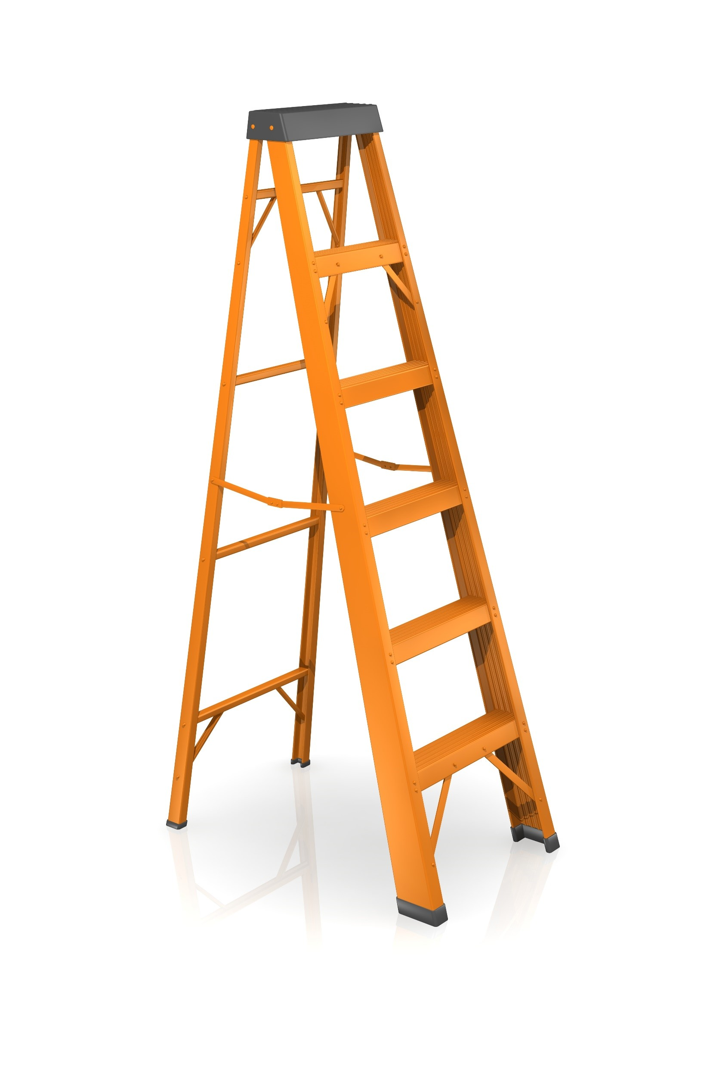

Ladder Inspection
Create Click and Reveal Interaction
Ladders must be inspected before each use.
Click on each icon to learn more.
Cracks and Weak Points: Check for any visible cracks or weak points in the ladder structure.
Bent Rungs: Ensure that the rungs are not bent or damaged.
Footing: Verify that the ladder's footing is stable and secure
Notes:
Regular ladder inspection is crucial to ensure safety. Click on each icon to learn more.

Slide 10

Ladder Safety Quiz
Test your knowledge on ladder safety and OSHA regulations.
Notes:
This quiz will help reinforce key ladder safety concepts, OSHA requirements, and hazard recognition to promote safe ladder use on job sites.

Slide 11

Multiple Choice Question
Interaction
What is the maximum height a portable ladder can be used without fall protection?
A) 6 feet
B) 10 feet
C) 12 feet
D) 15 feet
Notes:
The correct answer is B) 10 feet.

Slide 12

Multiple Response Question
Interaction
Which of the following are common ladder hazards? (Select all that apply)
A) Improper setup
B) Ladder feet not secure
C) Overreaching while working
D) Using a ladder on level ground
Notes:
Correct answers are A, B, and C. Option D is not a hazard if ground is level.

Slide 13
Drag and Drop Question
Interaction
Match the ladder type to its description:
Extension Ladder
Step Ladder
Needs to lean against a surface.
Designed for use in an opened-and-locked position.
should be secured at the top or bottom to prevent movement.
- Self-supporting and portable.
must extend at least 3ft. (0.9m) above the landing to provide a hand hold for getting on and off the ladder.
Do NOT if folded or in a leaning position.

